Slide 1

Smart Stormwater - Smart City System 2.0
Team Members: Leandro Gonzalez, Luis Herrnsdorf Product Owner: Emilio Lopez
Instructor: Masoud Sadjadi School of Computing and Information Sciences Florida International University
Final Presentation
Sprint 2018
Notes:
7 seconds.( I will select 2 best slides (i will give them extra points and students will present for CIS committee)
Greet your audience, thank them for attending your presentation, introduce yourself, introduce your project, introduce your team members, and quickly indicate what each of you did in a high-level manner, and put more emphasis on your part/contribution.

Slide 2
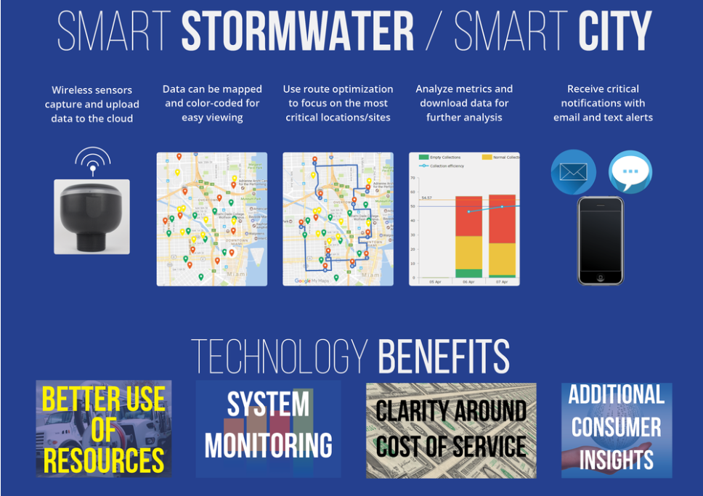
Project definition
Notes:
10 seconds.
Introduce the problem that the whole project (in all versions) tackles with GIF or screenshot.

Slide 3
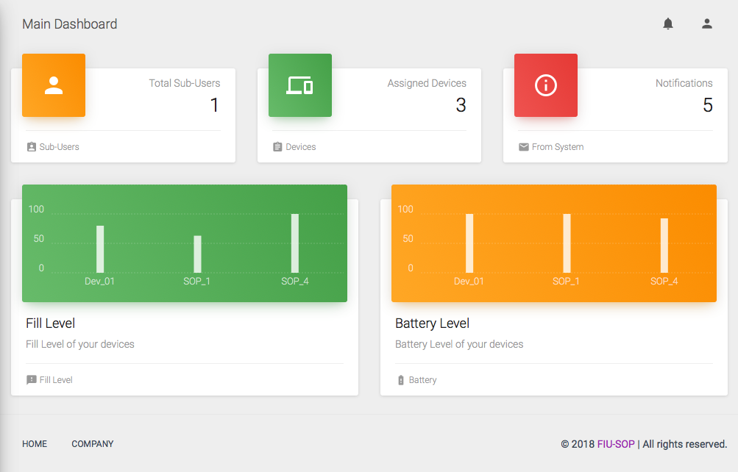
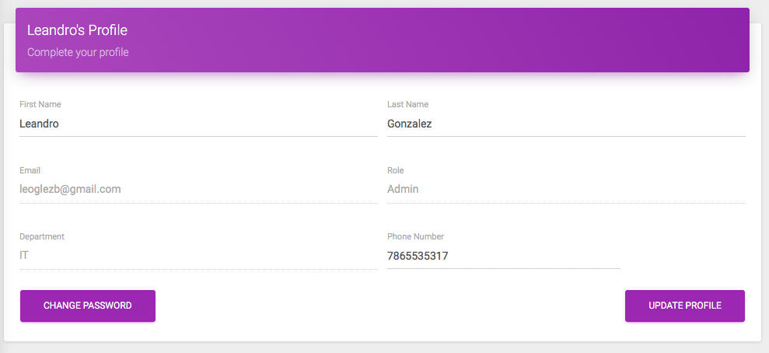
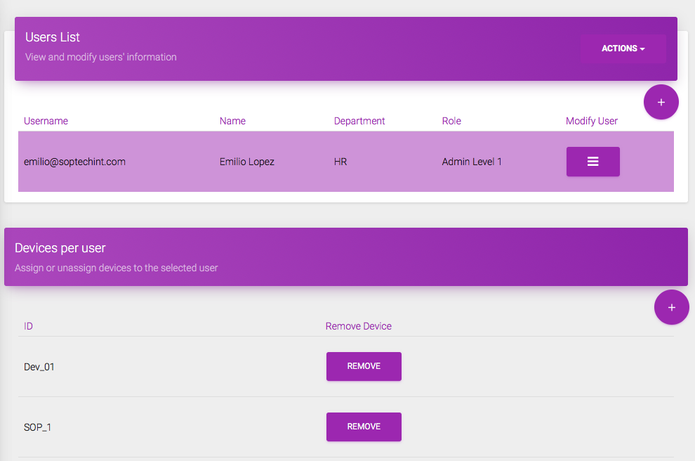
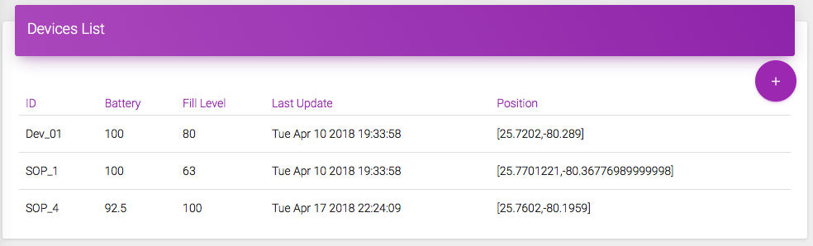
Project definition
Notes:
20 seconds.
Introduce the problem that the your project (in new version) tackles with GIF or screenshot.

Slide 4
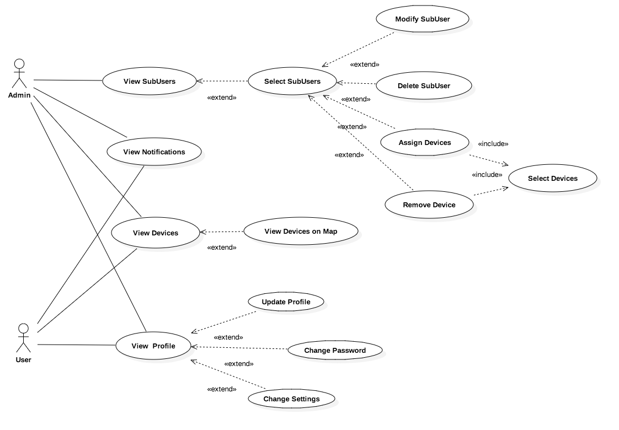
Requirements: Use Cases
Notes:
5 seconds
Show the Use Case Diagram for the whole project. Highlight your use cases.

Slide 5
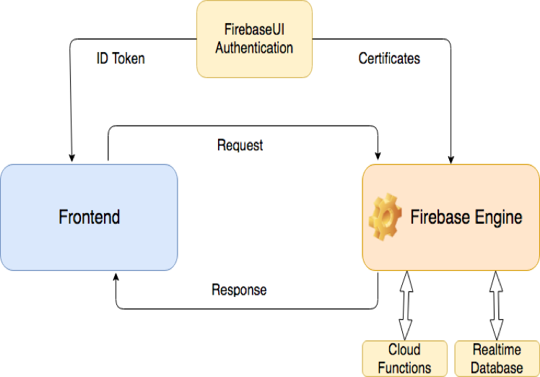
System Design: Architecture
Notes:
20 seconds
System design: Highlight the parts that you contributed to them.
1. System decomposition; identify the architecture patterns used
2. System deployment – h/w and s/w requirements

Slide 6
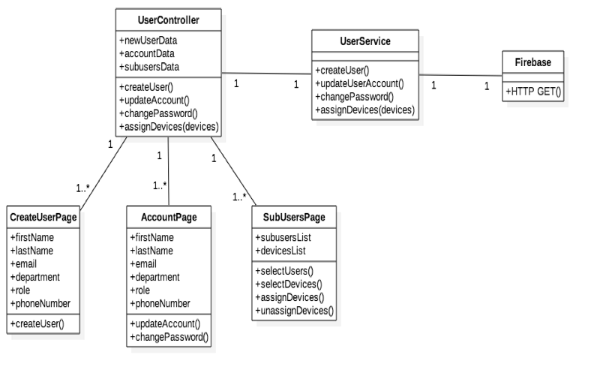
Minimal Class Diagram
Notes:
10 seconds.Minimal class diagram. Highlight the classes that you created/modified
Identify the design patterns used (one or more slides).

Slide 7
User Stories
User Story #670: Register Account
User Story #676: Change Account Settings
User Story #697: Assign Devices to Sub-user
User Story #704: See Device Assignments
User Story #731: Delete Sub-users
Notes:
5 seconds.
List the user stories that you worked on them.(put in order of importance). Stay focused on the parts that you have been working.

Slide 8
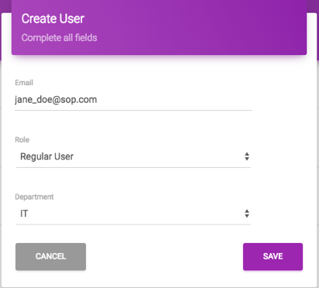
User Story #1
User Story #670: Register Account
Description: As an Admin I want to
be able to create new user
accounts (regular users or admins)
so that I can give access to the
application to others.
Notes:
60 seconds
The tile of user story
The most important user story you worked on it. You have to describe this one very well and be proud of that.
Please present and show the complexity of your work, code, algorithms, and technical challenges and technologies you have used. (you could use screenshot if you want. Visual presentations are better than text presentation)
Go into the details of the most important/significant tasks using bullet lists or visual graphs or state chart diagram
Sequence Diagram for this user story is mandatory (in another separate page if required)
Demo using screenshots or GIF (in another separate page if required)

Slide 9
User Story #2
User Story #676: Change Account Settings
Description: As a User I want to be
able to change my profile information
so that I can edit my phone
number, password, and name.
Notes:
20 seconds
The tile of user story
Please present and show the complexity of your work, code, algorithms, and technical challenges and technologies you have used. (you could use screenshot if you want. Visual presentations are better than text presentation) - Go into the details of the most important/significant tasks using bullet lists or visual graphs or state chart diagram - Demo using screenshots or GIF (in another separate page if required)
Sequence Diagram for this user story is optional

Slide 10
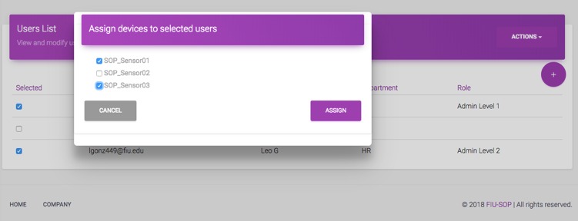
User Story #3
User Story #697: Assign Devices to Sub-user
Description: As an admin, I want to
be able to assign a device to a
sub-user so that he/she
can be in charge of the device.
Notes:
20 seconds
The tile of user story
Please present and show the complexity of your work, code, algorithms, and technical challenges and technologies you have used. (you could use screenshot if you want. Visual presentations are better than text presentation) - Go into the details of the most important/significant tasks using bullet lists or visual graphs or state chart diagram - Demo using screenshots or GIF (in another separate page if required)
Sequence Diagram for this user story is optional

Slide 11
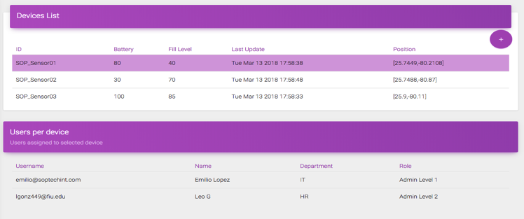
User Story #4
User Story #704: See Device Assignments
Description: As an admin, I want to
be able to see the sub-users assigned
to my devices so that I am able to
keep track of the users that have
access to my devices.
Notes:
20 seconds
The tile of user story
Please present and show the complexity of your work, code, algorithms, and technical challenges and technologies you have used. (you could use screenshot if you want. Visual presentations are better than text presentation) - Go into the details of the most important/significant tasks using bullet lists or visual graphs or state chart diagram - Demo using screenshots or GIF (in another separate page if required)
Sequence Diagram for this user story is optional

Slide 12
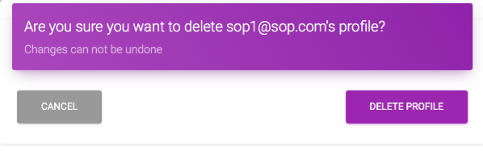
User Story #5
User Story #731: Delete Sub-users
Description: As an Admin, I want to be able to
delete a sub-user’s account, so that I can
revoke a user’s access to the system.
Notes:
20 seconds
The tile of user story
Please present and show the complexity of your work, code, algorithms, and technical challenges and technologies you have used. (you could use screenshot if you want. Visual presentations are better than text presentation) - Go into the details of the most important/significant tasks using bullet lists or visual graphs or state chart diagram - Demo using screenshots or GIF (in another separate page if required)
Sequence Diagram for this user story is optional

Slide 13
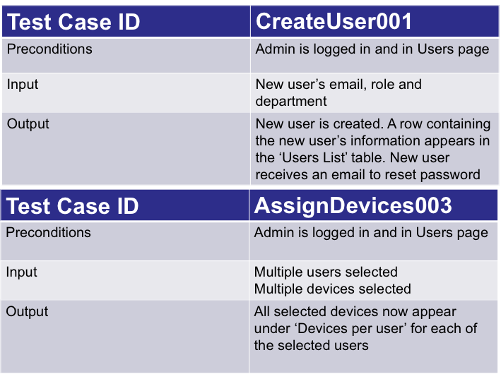
Test Suites and Test Cases
Notes:
10 seconds
A description of verification process and Test Suites and Test Cases for one of the use cases.
1 One sunny day and one rainy day for the implemented use cases (one or more slides).
2 Automated test scripts for the implemented use cases (if any) (one or more slides).

Slide 14




Summary
Help save the planet: Stop Ocean Pollution
Contact me: lgonz449@fiu.edu
Thank You!
Notes:
10 seconds
Summarize your contribution, mention your effort for Scrum, Mingle, Github, Google Drive Documentation and minutes
Include your contact information
Ask if anyone has any questions for you.
Thank your audience

